Slide 1
Sentiment Analysis

Slide 2
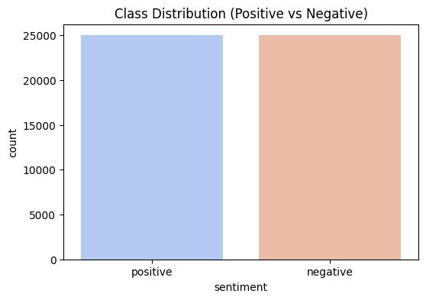
📊 Dataset Overview (IMDB Sentiment Dataset)
Shape: 50,000 rows × 2 columns
Columns: review (text), sentiment (label)
Classes:
Positive → 25,000 reviews
Negative → 25,000 reviews
Balanced dataset ✅

Slide 3
Text Cleaning & Preprocessing
Tags → Eliminates unwanted formatting (<br>, <p>, etc.)
Keep OnRemoved HTML ly Letters → Removes numbers, punctuation, and symbols for cleaner text
Lowercasing → Ensures uniformity by converting all words to lowercase
Remove Extra Spaces → Replaces multiple spaces with a single space
Create Clean Column → Stores preprocessed reviews in clean_review
Label Encoding
Map positive → 1 and negative → 0
Creates numerical label column for model training
Impact
Text becomes consistent and noise-free
Data is ready for tokenization/vectorization
Enables effective model training and evaluation

Slide 4
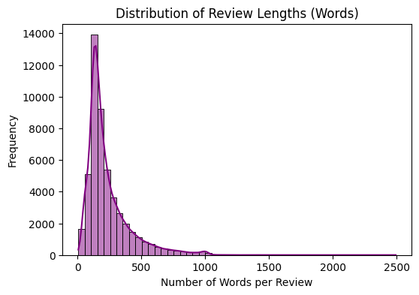
Distribution of Review Lengths
Range & Outliers
Maximum review length extends up to ~2500 words.
Reviews beyond 1000 words are rare (long-tail behavior).
Long reviews are outliers but often contain rich, detailed insights.
Practical Implications
Data Preprocessing: May need normalization/handling of extreme lengths.
Business Insight: Short reviews provide bulk feedback, but long reviews may hold in-depth insights.

Slide 5
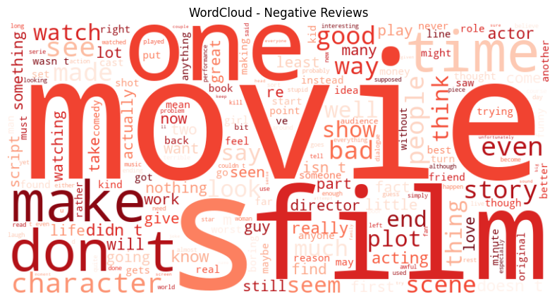
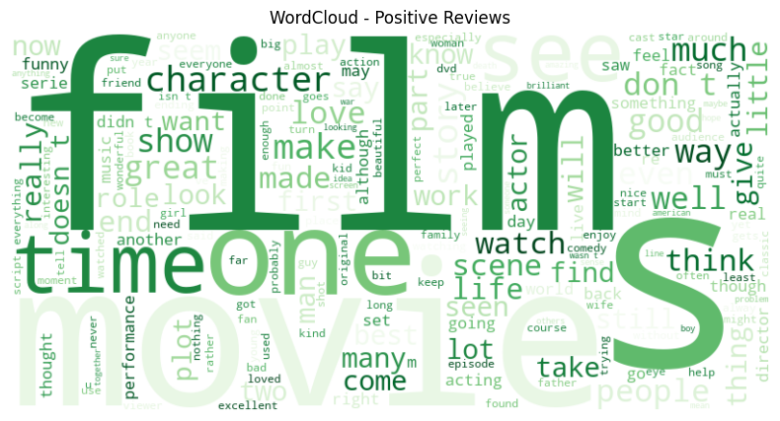

Slide 6
Train-Test Split & Normalization
Split dataset into training (80%) and testing (20%), keeping label balance (stratified split).
Extracted review lengths and normalized them with MinMaxScaler.
.
✅ Purpose: Ensure fair moSaved the scaler for later usedel evaluation and normalize review length as an auxiliary feature.
Stratified Split → preserves class balance for fair evaluation.
Normalization → ensures review length is on the same scale as other features.
Features with large values (like review length in hundreds) can dominate smaller-scale features (like embeddings).
Keeps optimization stable and training faster.
Fit on Train Only → avoids data leakage (test data influencing training).

Slide 7
Tokenization (Text → Numbers)
✅ What we did:
Used Keras Tokenizer to convert text reviews into sequences of integers.
Each unique word got mapped to a unique index (e.g., “good” → 12, “bad” → 45).
Kept only the top 10,000 most frequent words (MAX_WORDS=10000) to reduce noise.
🎯 Why we did this:
ML/DL models can’t work directly with raw text.
Tokenization transforms unstructured text into structured numeric form.
Restricting vocabulary improves training efficiency & avoids overfitting.
📊 Output:
Training set size: 40,000 reviews
Test set size: 10,000 reviews

Slide 8
Sequence Padding (Equalizing Input Lengths)
✅ What we did:
Fixed sequence length to 200 tokens (MAX_LEN=200).
Reviews shorter than 200 → padded with zeros.
Reviews longer than 200 → truncated.
🎯 Why we did this:
Deep learning models (like LSTM) require fixed-size inputs.
Padding ensures uniform shape, making batch training possible.
Truncating prevents excessively long reviews from dominating training.
📊 Output:
X_test_pad shape: (10000, 200)

Slide 9
Model building
Model building
What we did:
Built a Neural Network with Embedding + LSTM layers.
Embedding layer converts words → dense vectors.
LSTM captures sequence dependencies in text (good for sentiment).
Added Dense layers for classification (positive vs negative).
Why:
LSTMs are excellent for text sentiment because they learn long-term dependencies.
Embeddings reduce dimensionality and improve generalization.

Slide 10
Model Training
Model Training
What we did:
Trained on 40,000 reviews (train set).
Validated on 10,000 reviews (test set).
Used Adam optimizer + binary crossentropy loss.
Trained for 5 epochs.
Why:
Training helps the model learn patterns in reviews (e.g., “great” → positive, “boring” → negative).
Validation helps prevent overfitting.
Training Output (Your Logs):
Epoch 1: Accuracy = 75.26%, Val Accuracy = 85.86%
Epoch 2: Accuracy = 87.11%, Val Accuracy = 87.30%
Epoch 3: Accuracy = 90.46%, Val Accuracy = 87.84% ✅ Best epoch
Epoch 4–5: Accuracy increases but Val Accuracy drops slightly → overfitting start

Slide 11
📊 Model Evaluation
✅ Test Accuracy: 87.4% ✅ Test Loss: 0.3695
🔹 Insights:
Accuracy above 85% indicates the model generalizes well.
The relatively low loss shows the model is making fewer wrong predictions.
The model effectively distinguishes between positive vs negative reviews.
Metric | Negative Reviews | Positive Reviews
Precision | 0.90 | 0.85
Recall | 0.84 | 0.91
F1-Score | 0.87 | 0.88
Negative Reviews (Precision = 0.90) → The model is very good at correctly identifying true negatives (less false positives).
Positive Reviews (Recall = 0.91) → The model rarely misses true positives.
Balanced Performance → Both classes have F1-scores ~0.87–0.88, showing consistent results.
Overall Accuracy = 87% on 10,000 test samples.

